Slide 1
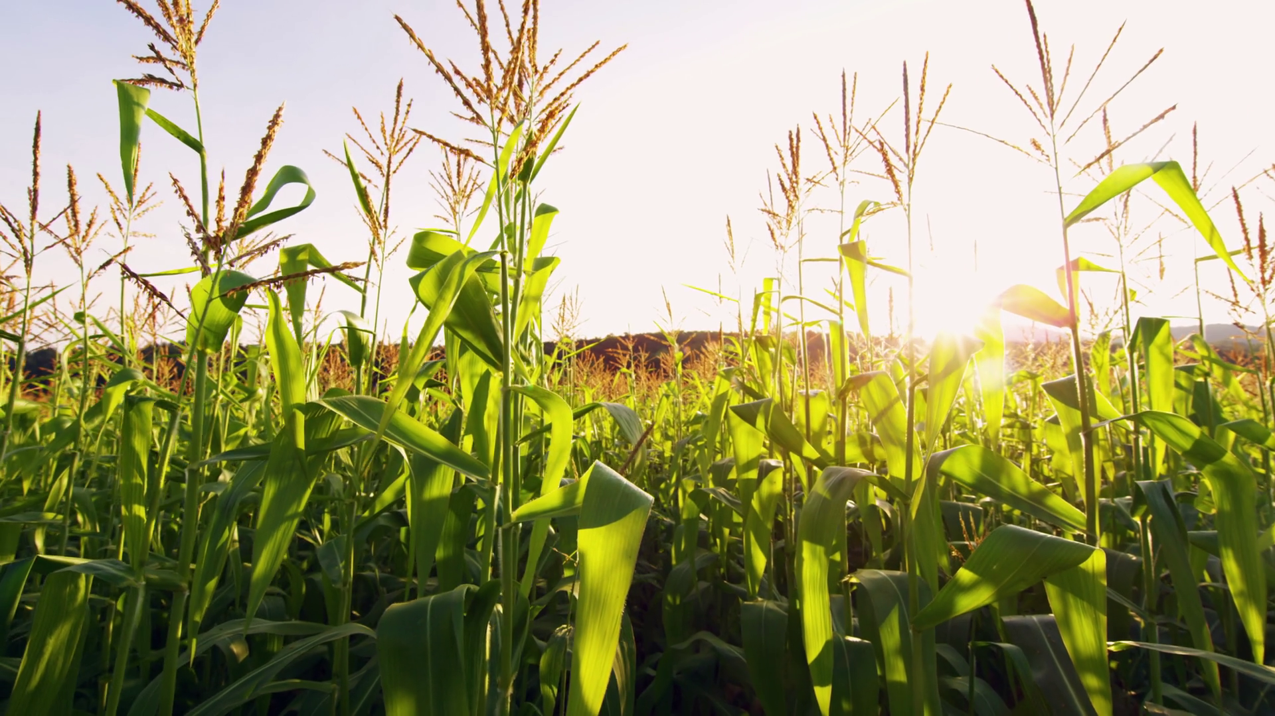
Balanced scorecard slide 1
Drone Doctor
Early Crop Disease Prediction and Support System for Farmers
By – Abhyuday NSKHD

Slide 2
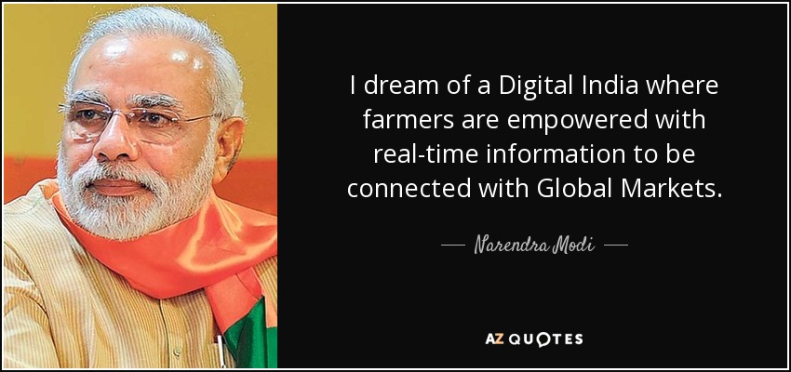

Balanced scorecard slide 2
.
.
.

Slide 3
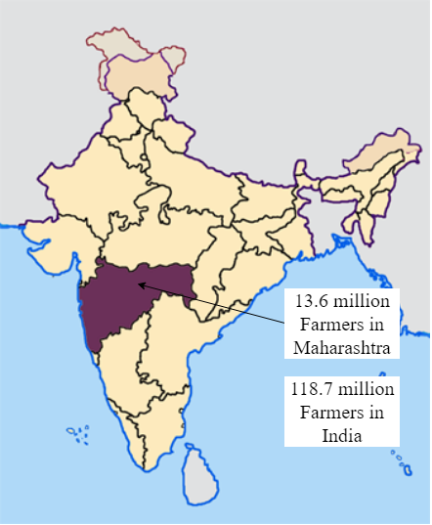
Balanced scorecard slide 2
About Farmers
.
.
.

Slide 4
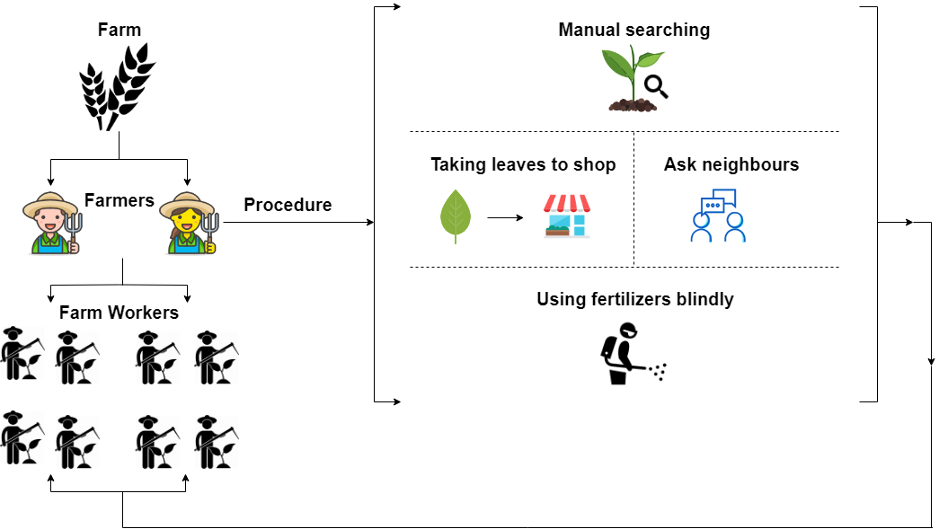
Balanced scorecard slide 2
Ecosystem of Farmers

Slide 5
Balanced scorecard slide 3
Needs of Farmers
More yield from crops
Effortless early crop disease detection
Appropriate solution for a specific disease from a trusted source
Alerts for safety precautions
Reasonable market price for pesticides
Proper guidance for precautions in future

Slide 6
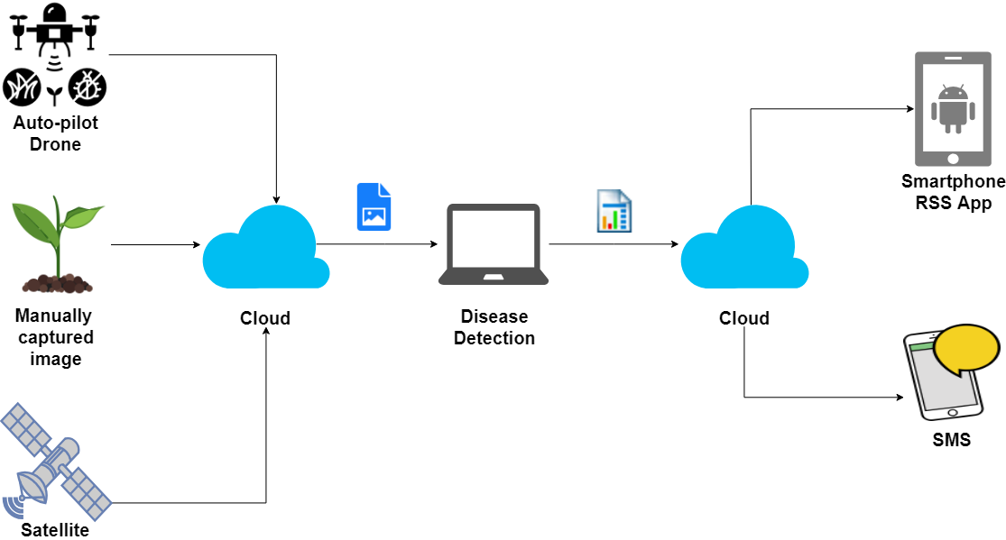
Balanced scorecard slide 3
Mechanism

Slide 7
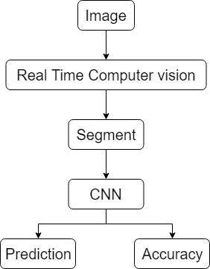
Balanced scorecard slide 3
Proposed Solution

Slide 8
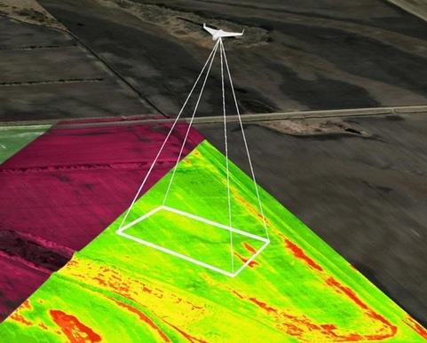
Balanced scorecard slide 3
Auto-pilot Drone

Slide 9
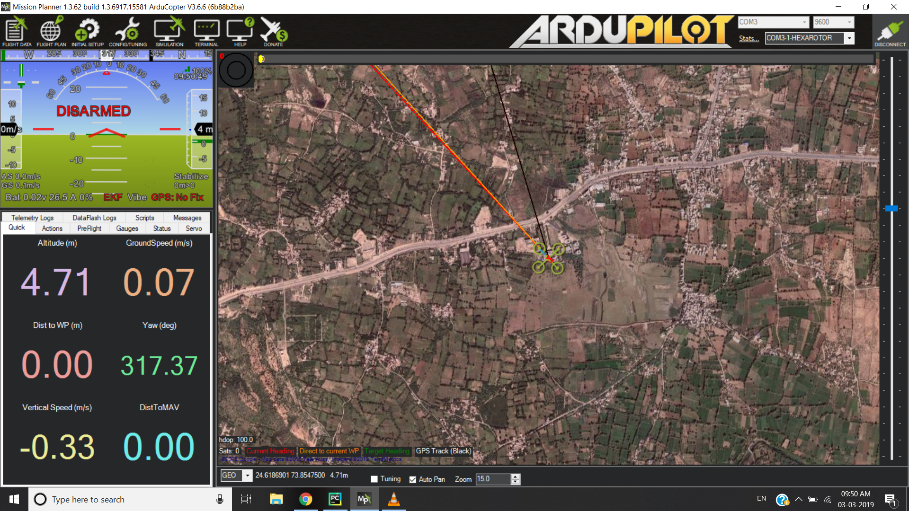
Balanced scorecard slide 3
Drone Interface

Slide 10
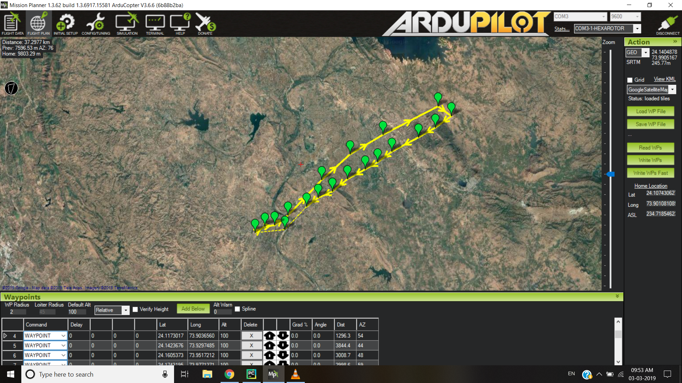
Balanced scorecard slide 3
Drone Interface

Slide 11

Balanced scorecard slide 3
Disease Detection
Train a CNN on different categories of datasets
Using keras with tensorflow backend

Slide 12
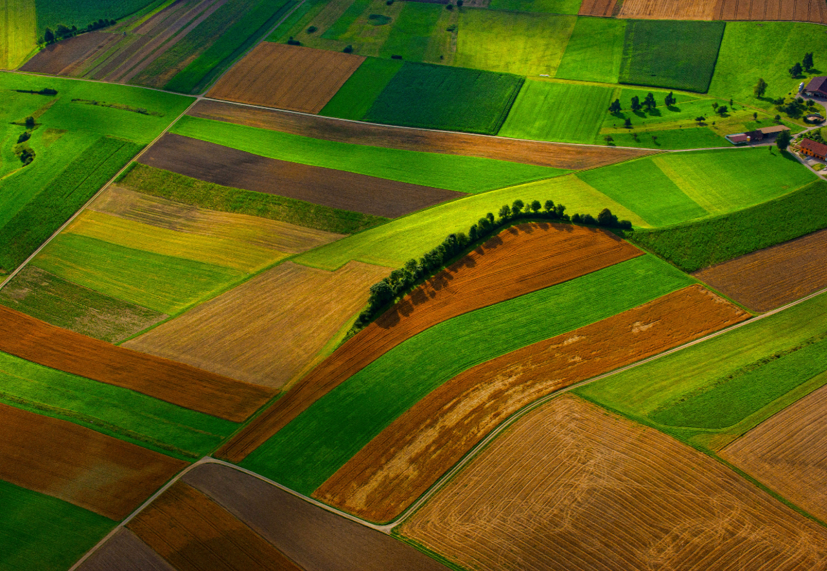
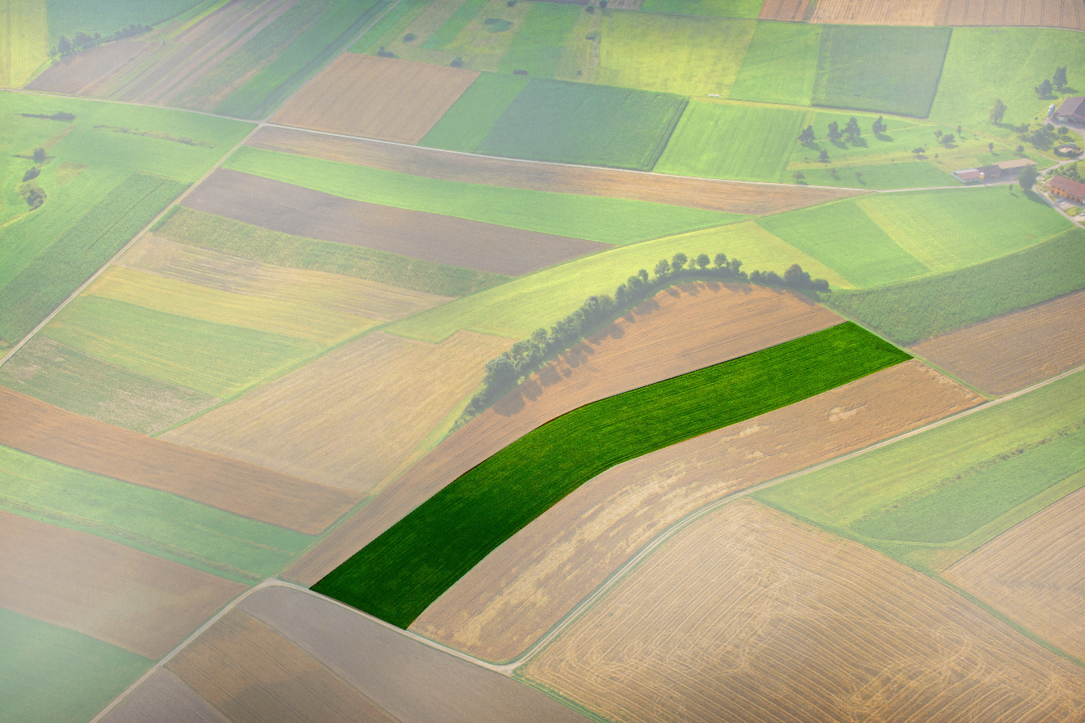
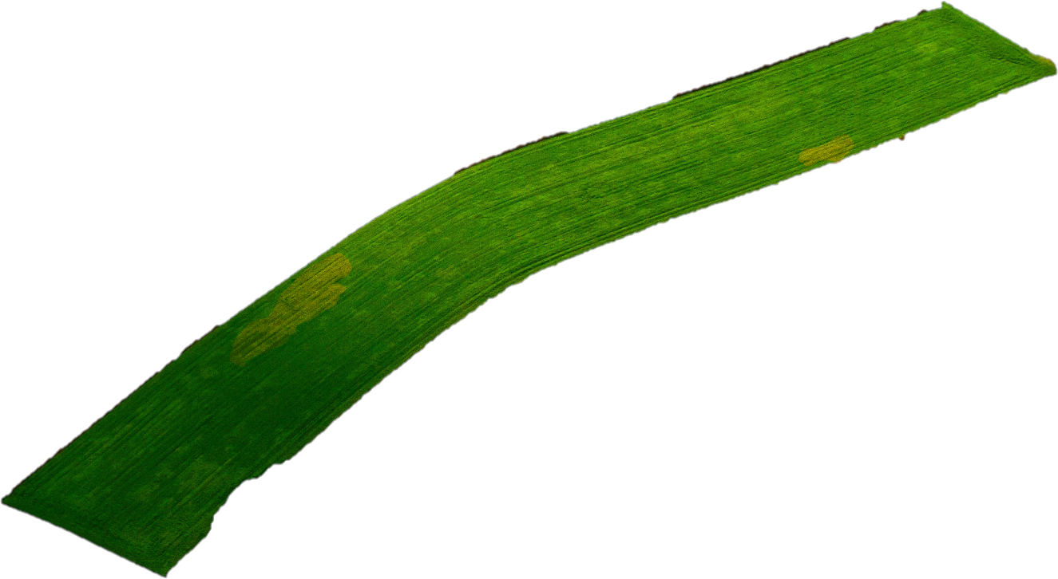
Balanced scorecard slide 3
Selecting the field

Slide 13
Balanced scorecard slide 3
Semantic Segmentation
Classification
2. Localization/Detection
3. Inference prediction

Slide 14
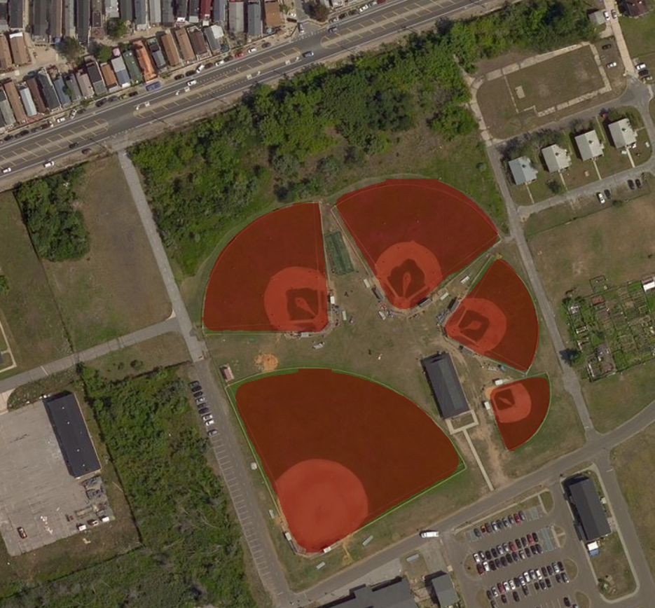
Balanced scorecard slide 3
Segmentation through VGG16

Slide 15
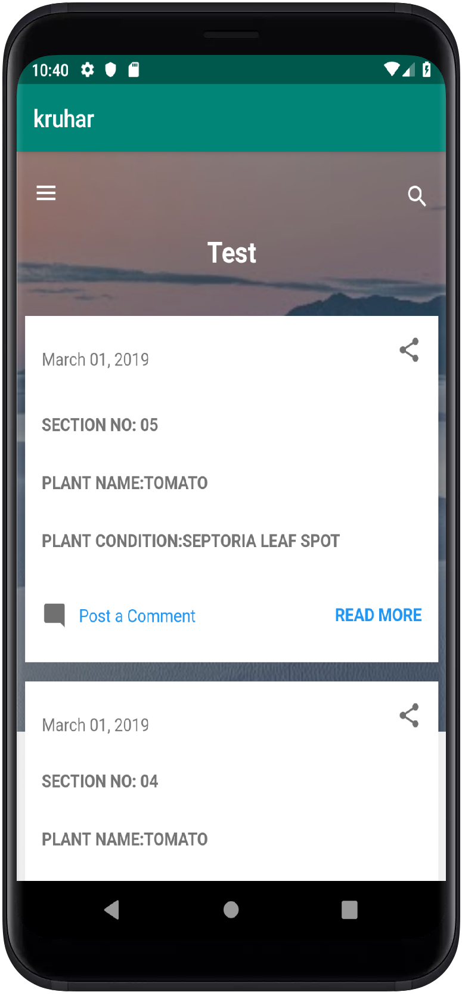
Balanced scorecard slide 3
Android Application
Real-time alerts
Multimedia support
Solution product link
Guidance from expert

Slide 16
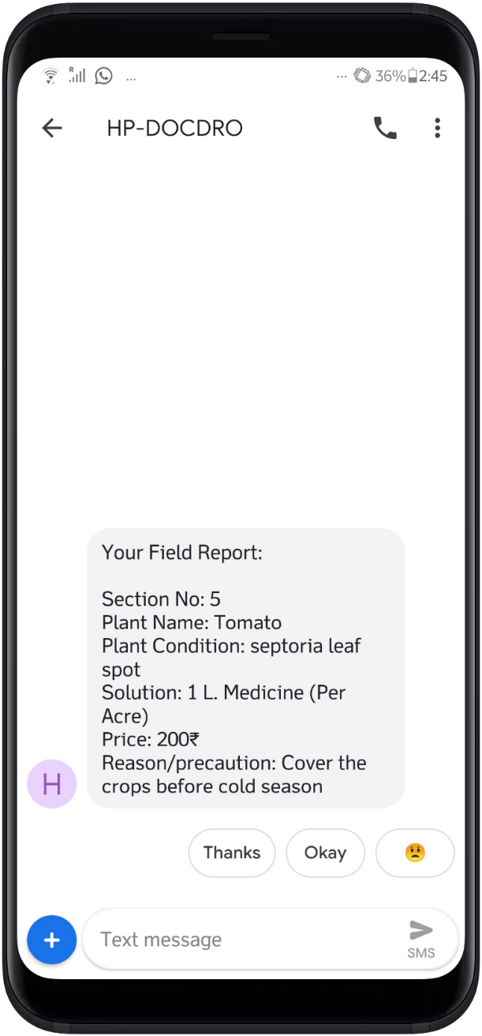
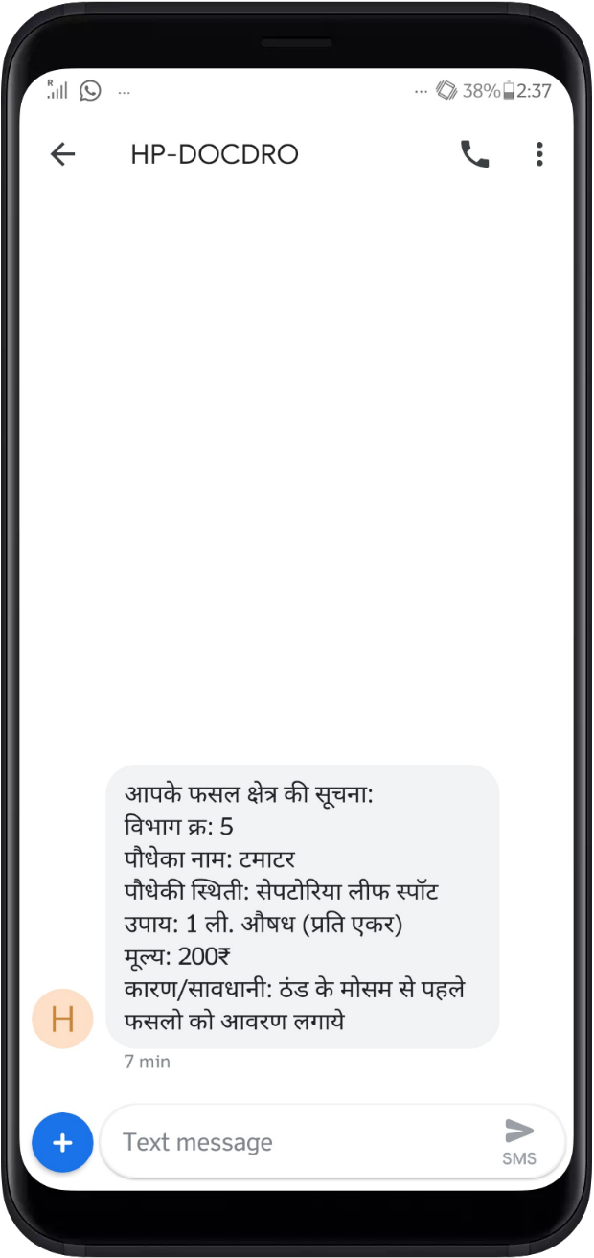
Balanced scorecard slide 3
SMS Notification
Real-time alerts
Multi-language support
Trusted source
Market price
Solutions from expert

Slide 17
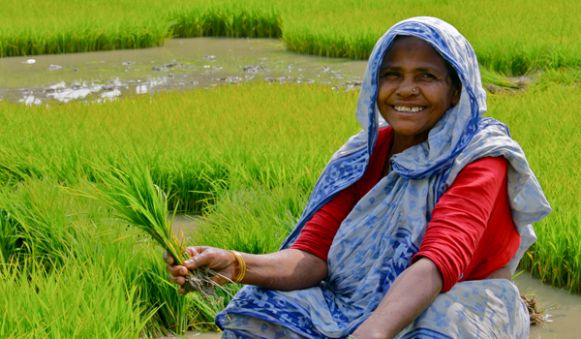
Balanced scorecard slide 3
Vision
Increase the income of the farmers
Collecting the data of the yield from the crops periodically to analyse the impact of our solution
To create more jobs in the related field

Slide 18
Balanced scorecard slide 3
Conclusion
Easy and accurate crop disease detection
Possibility to increase the yield
Reduction in mental stress for farmers
Better soil health

Slide 19
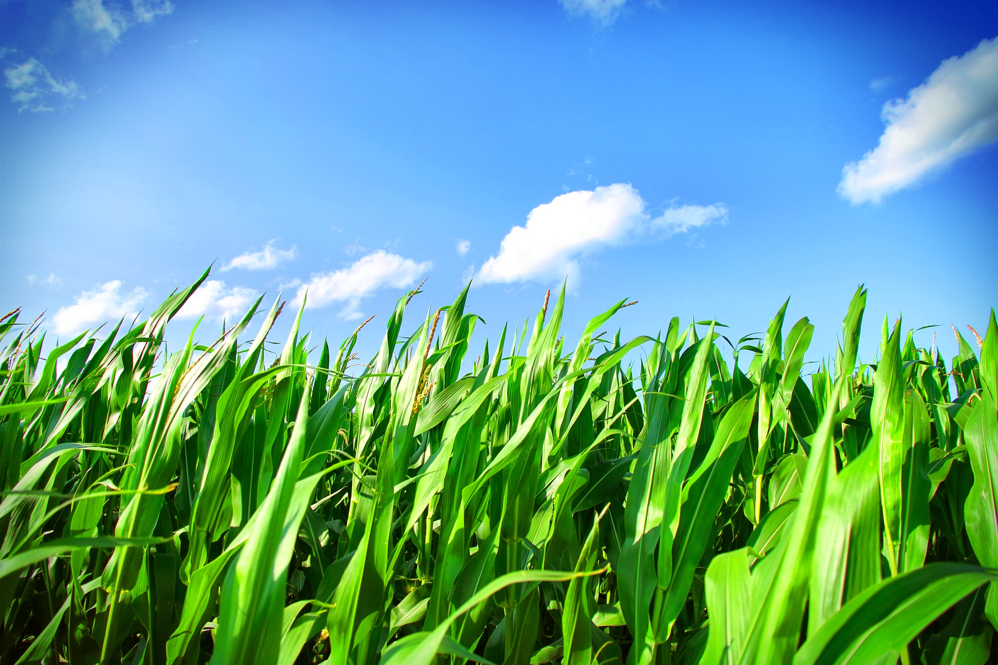
Balanced scorecard slide 10
THANK YOU

